Slide 1


AIML & Data Science
Free Workshop
FOR
Netaji Subhash Engineering College
Make India
an AI
Super Power
IoT, Robotics
& AI Study
IT
Competency
nodiam, Education that enlightens!
Dependable Competency Partners
Expert Industry Veterans
Lucid & Practical
Scientific
Knowledge
nodiam – Private & Confidential – 2023 ©

Slide 2

AI Is Not Rocket Science
Our mentors will help you:
Comprehensive teaching
Python computing skills & all relevant libraries
TensorFlow, Keras, Pytorch etc.
Data Science, Analytics & Data Visualization
NumPy, Pandas, Matplotlib etc.
Generative AI - ChatGPT
Machine Learning & MLOps
Deep Learning & Neural Networks
Computer Vision, LLM, GAN, NLP etc.
IoT & Robotics
Hands-on labs & industry exposure
Free internship & live project experience
Free career guidance
nodiam – Private & Confidential – 2023 ©

Slide 3
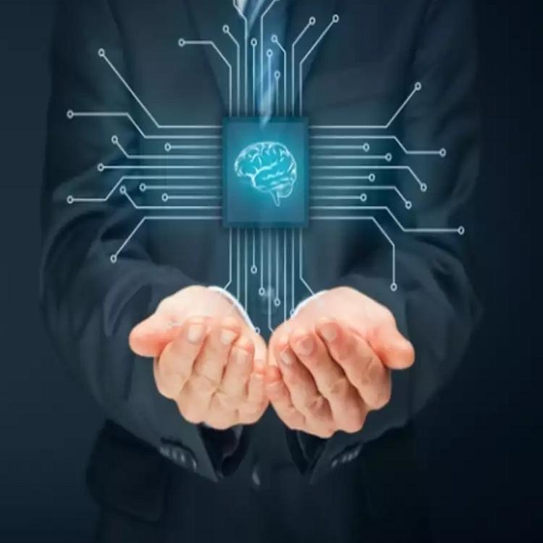
Job Opportunities in AI & Data Science
Professionals in Demand
Data Scientists
Machine Learning Engineers
NLP, CV, LLM, GAN Specialists
IoT Specialists & Robotics Engineers
Salary Band
Highest paid professionals in India & abroad
Fastest growing careers, globally
Highest vacancy rates in job sites
AI won’t replace humans. But those with AI will replace those without AI.
nodiam – Private & Confidential – 2023 ©

Slide 4

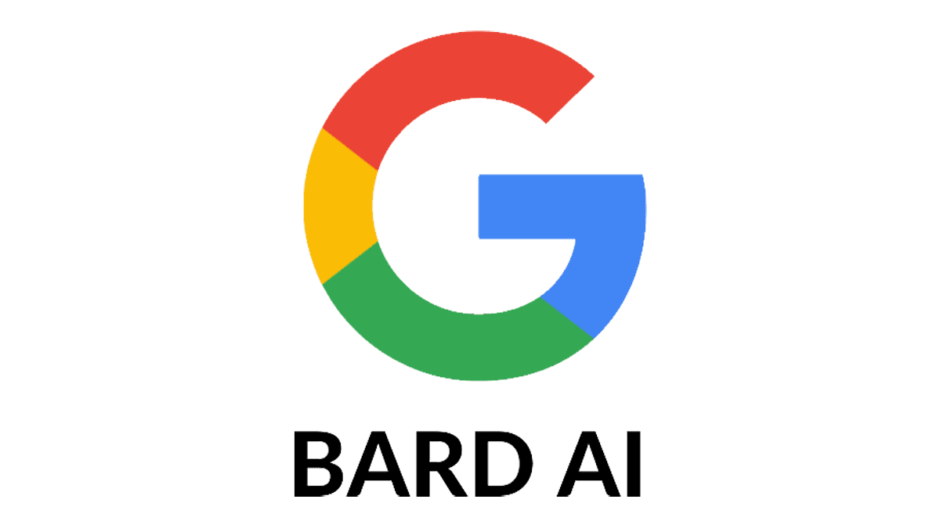



Explore the Trend with nodiam
Creativity
Deep Learning
Mathematics
Neural Networks
Statistics
Machine Learning
Coding
Data Science
Learn to Leverage Generative AI
Different models and pipelines
Prompt Engineering
RAG Technique
Langchain, Gradio for AI based apps
Deploy your own chatbot
Exciting NLP projects
nodiam – Private & Confidential – 2023 ©

Slide 5

AI Supports All Professions
Economists, Social Scientists, Geologists and all
Multimedia Composers, Musicians, Movie Makers
Doctors & other Medical Professionals
Scientists, Mathematicians & Researchers
Corporate Strategists, Bankers & Lawyers
Civil, Mechanical, Chemical & all Engineers
nodiam – Private & Confidential – 2023 ©

Slide 6
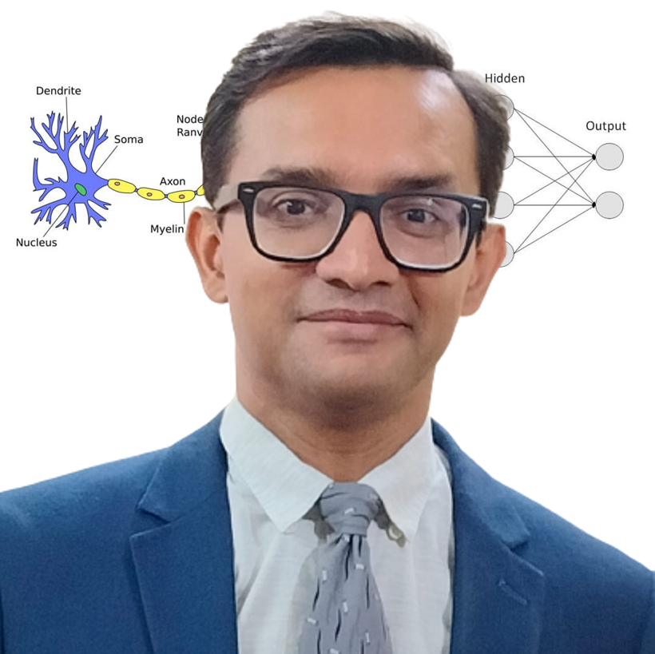
AI & Python Faculty
Anirban Chakrabarty, C.E.O.
B.E.(Electronics), M.B.A. (Finance)
anirban@anodiam.com
+91 9073 700094 / +61 470 142 229
Empathetic, Dynamic, & Supportive
24 years of blue-chip experience
Corporate trainer & excellent communications
Dynamo of energy, dependable & trusted for the job! – Vish Coosa, Morgan Stanley, U.S.A.
Thorough Knowledge, Can Make Difficult Concepts in AI Seem Lucid
Worked on multiple Corporate AI projects globally
Elementary thinker, visualizes subject matter through clutter & noise
Improved accuracy of AI models singlehandedly up to 99.8%
Super brain, the best guy to take care of all our AI implementation! – Government Client
nodiam – Private & Confidential – 2023 ©

Slide 7
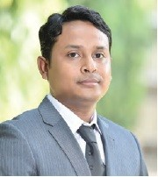
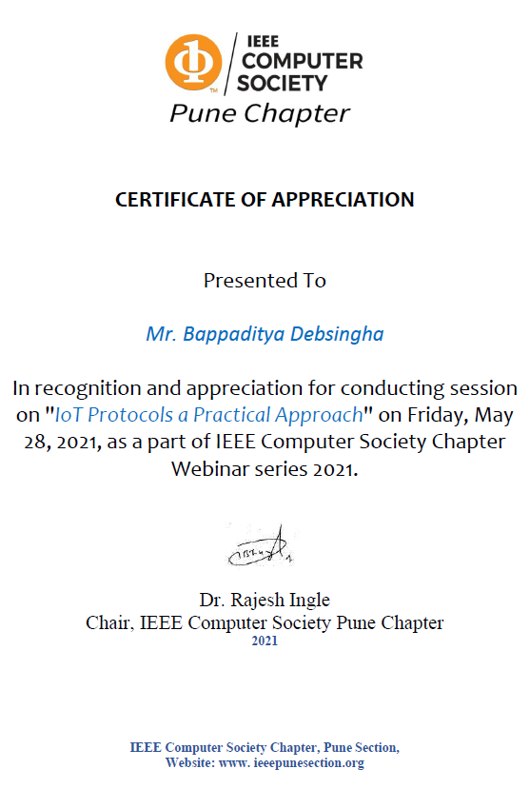
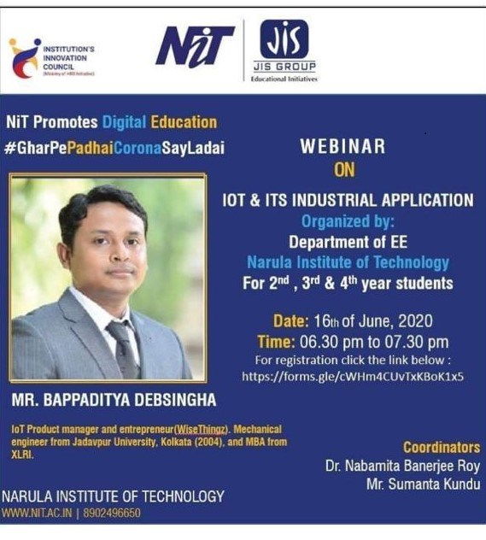
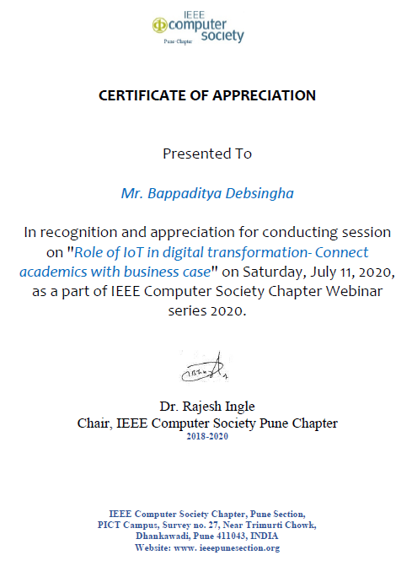
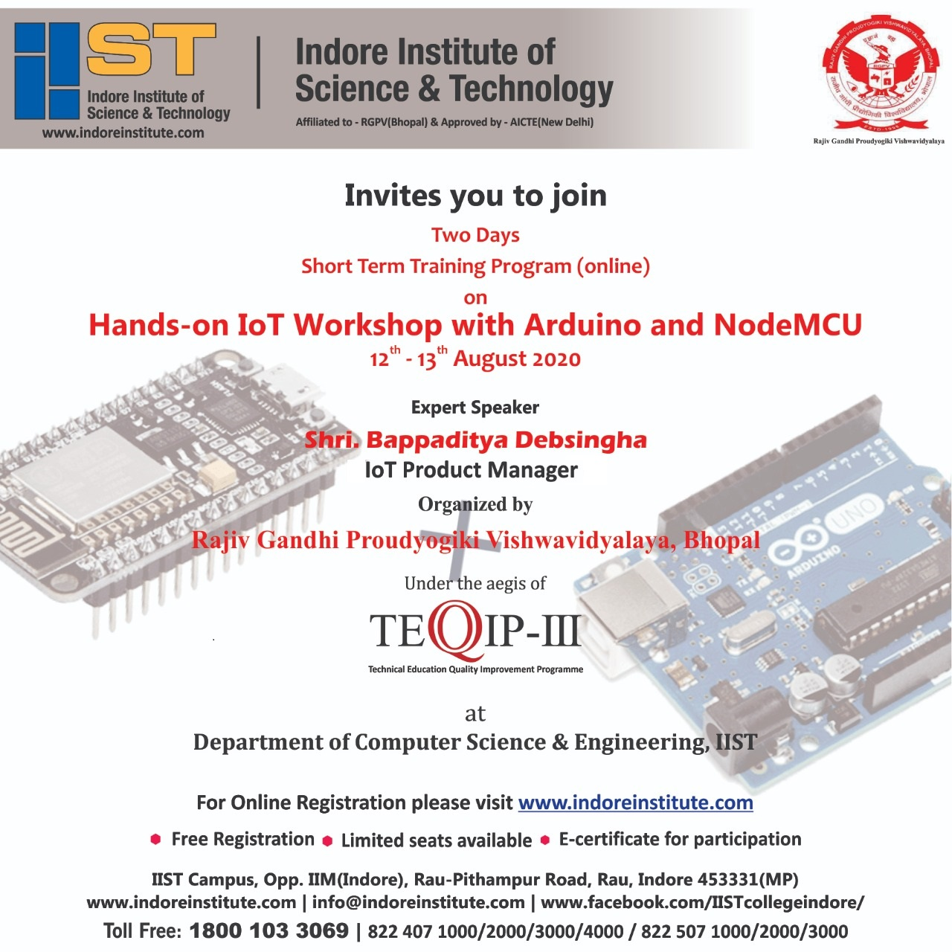
Robotics & IoT Faculty
Bappaditya Debsingha, IoT Prod Manager
B.E.(J.U., Mechanical), M.B.A.(XLRI)
https://www.youtube.com/c/wisethingz
https://www.instagram.com/bappa_wt
www.wisethingz.com
Inspiring Mentor, Innovative & Entrepreneurial
18 years of global experience
Trained hundreds of children & industry professionals
IoT & Robotics workshops at institutions & corporates
Industry Leading S.M.E. in the fields of
Autonomous machines, automation, sensors & IoT driven BI
Analytics dashboards, Cloud API gateways, integration to mobile apps
nodiam – Private & Confidential – 2023 ©

Slide 8

AIML & Data Science Bootcamp: Iron Shield 2024
ABSOLUTELY FREE!
2 hours of Workshop and 1 Hour orientation
At your facility if > 50 attendees
at Anodiam conference Hall if < 50 attendees
Online Webinar if < 10 attendees
All Teachers, Students and Guardians are welcome!
GRAB BEFORE IT’S GONE!
nodiam – Private & Confidential – 2023 ©

